Slide 1
Lecture 1: How is switch changing the world?

Slide 2
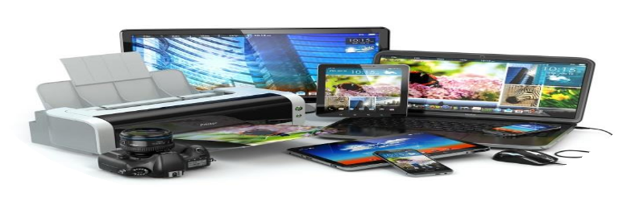
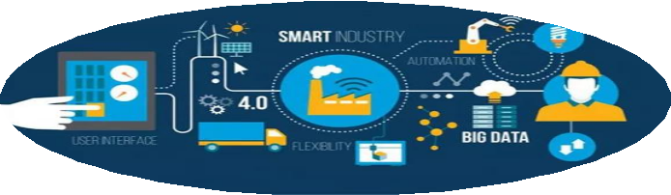


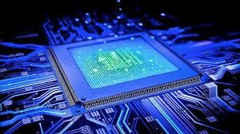
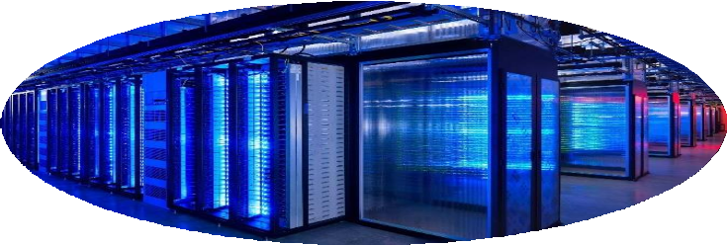


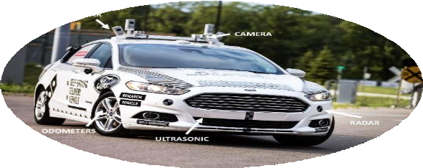
Impact of Electronics
Personal
Industry
Healthcare
Internet
~$500 billion market in 2019
Supercomputer
Visual Reality
Artificial Intelligent
Self-Driving

Slide 3
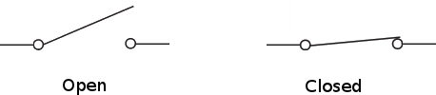
Everything Starts with Switch
Information Processing Based on 0 and 1
0 1
Key features of a switch
On/Off
ON ⬄ Short circuit ⬄ a piece of conducting wire. OFF ⬄ Open circuit ⬄ an open gap in the circuit.
Control
On and off states of a switch can be controlled.

Slide 4
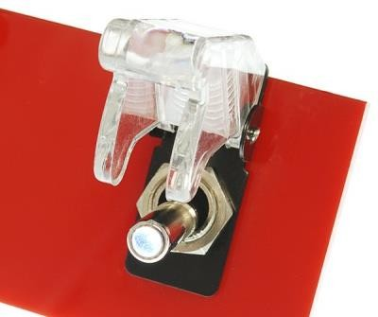
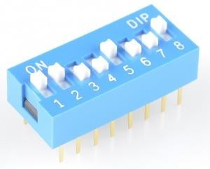
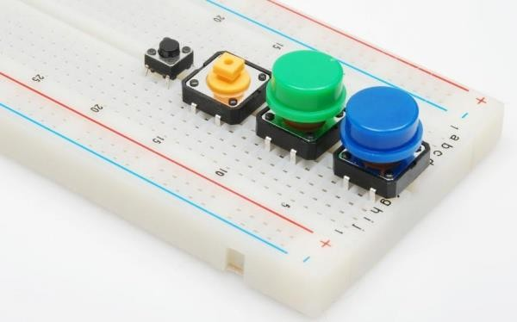
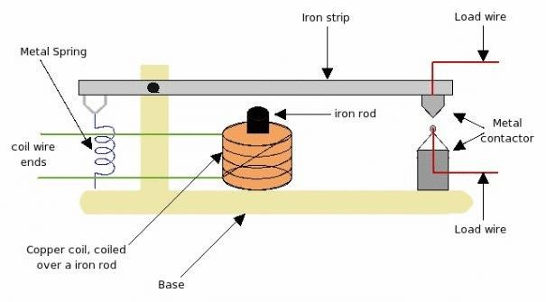
Switch Examples
Mechanical Switches
Relay
Clumsy
Slow
Not Electronic

Slide 5
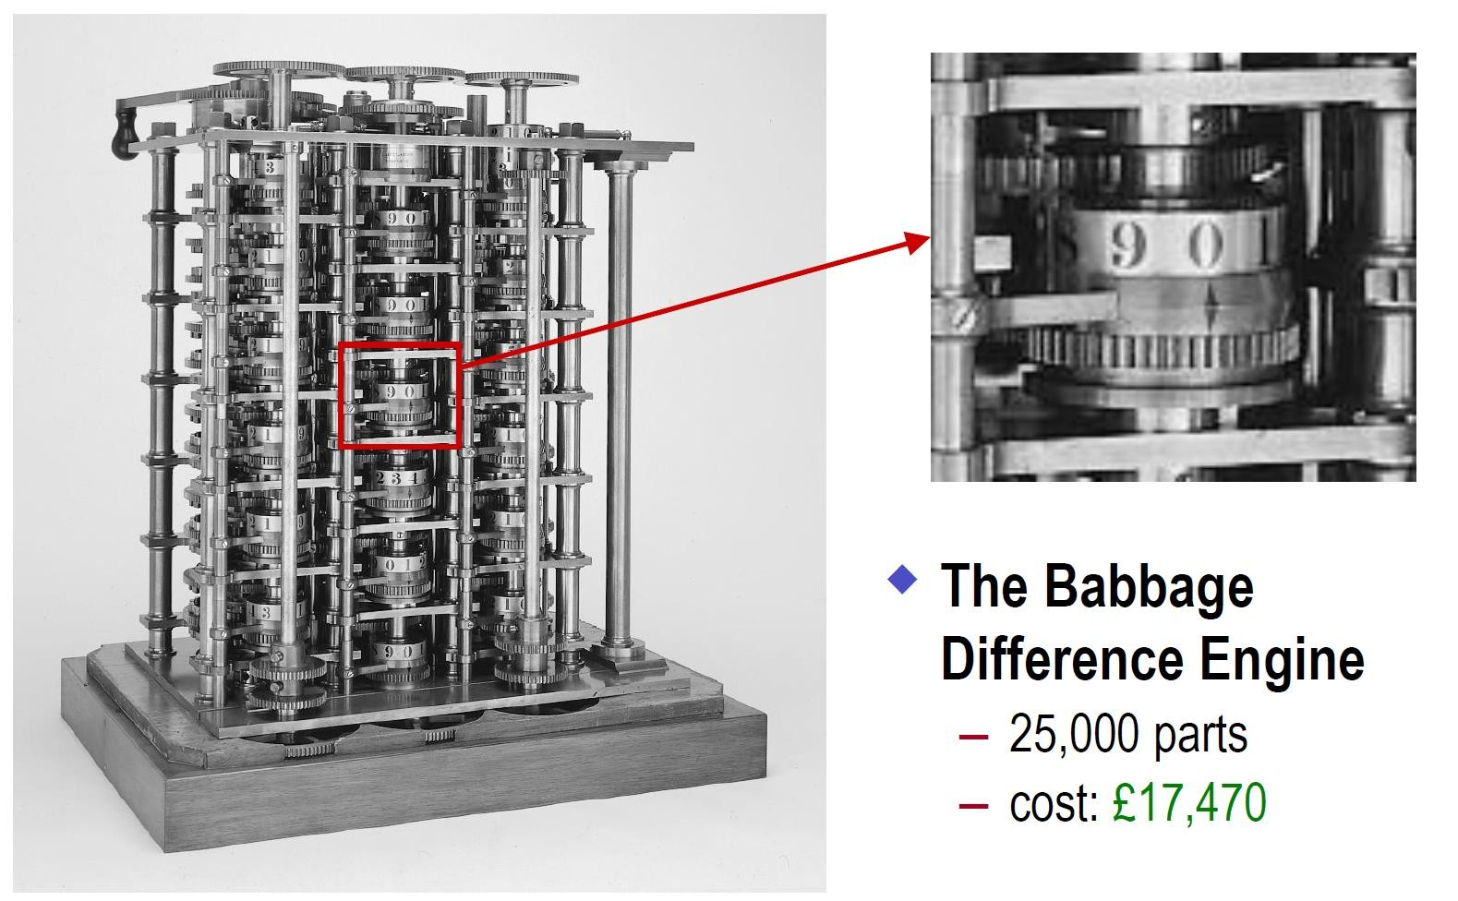
The First Computer (1832)
Babbage’s Difference Engine
25,000 parts.
Cost: ￡17,500
Weight: 6 tons
1/7 completed, operated on 6-digit numbers and second- order differences.
Cannot perform a conditional branch – NOT Turing Machine

Slide 6
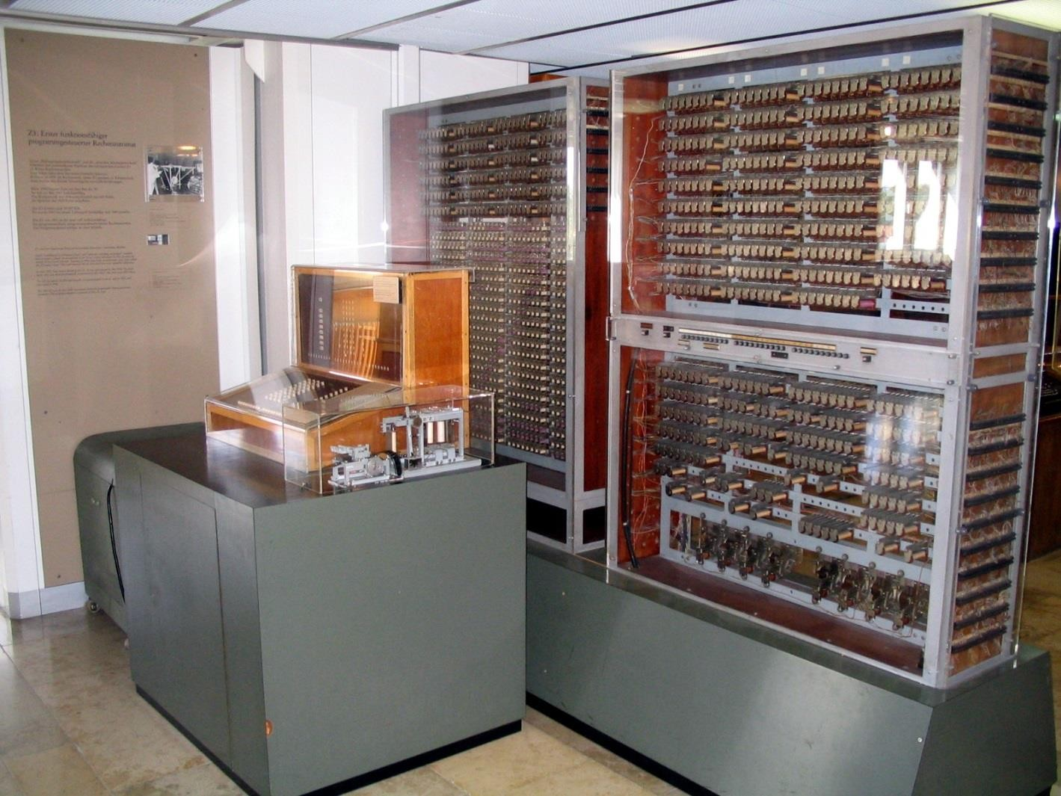
The First Digital Computer (1941)
Zuse Z3
2,000 relays
22-bit word length
5-10 Hz
Not fully electronic
No conditional branch instruction*.
Practically, Z3 is not equivalent to
modern computers.
Device: Electro-mechanical relay

Slide 7

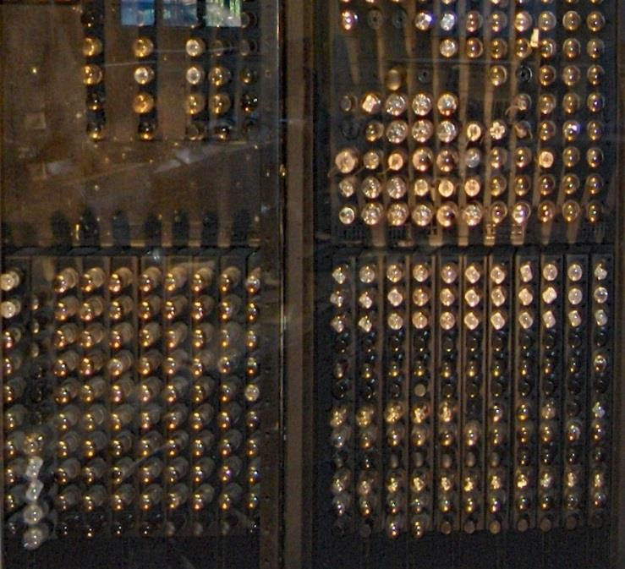
Vacuum Tube & ENIAC
17468 vacuum tubes, 7200 diodes,
1500 relay
5000 +/- op/s, 385 * op/s
2.4 m × 0.9 m × 30 m, area size: 167 m², weight: 27 t, Power: 150 KW
Longest Operation Time: 116 hr.

Slide 8
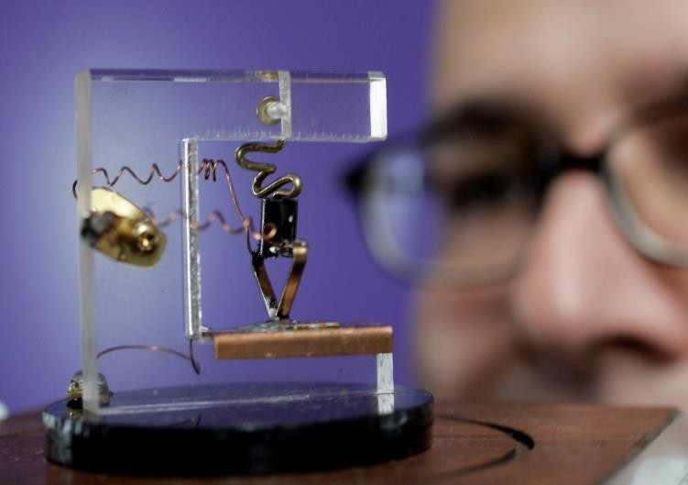
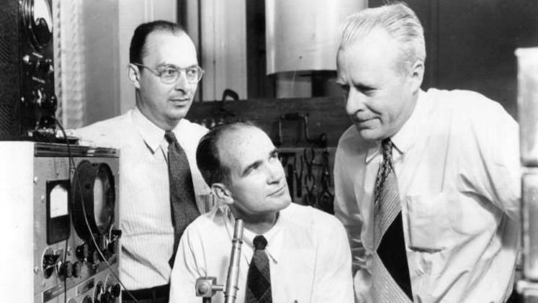
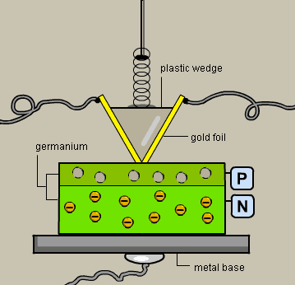
Ge Point Contact Transistor
John Bardeen
Walter Brattain
William Shockley
First Ge-based point-contact transistor exhibited oscillator behavior, a critical test to prove the existence of power in December 1947. – A new age has come.

Slide 9
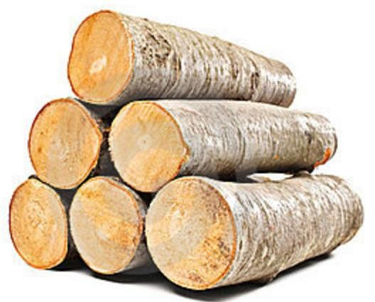
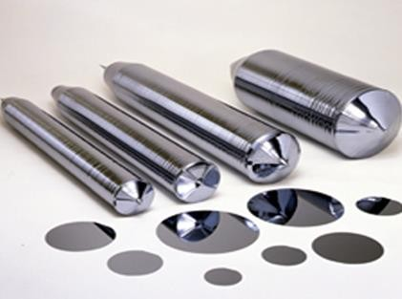
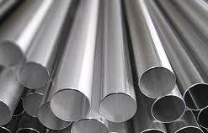
Classification of Solids
Insulator
Semiconductor
Metal
No conduction at all!
Always OFF
Conduction occurs in certain conditions OFF ON
Current cannot be controlled Always ON

Slide 10
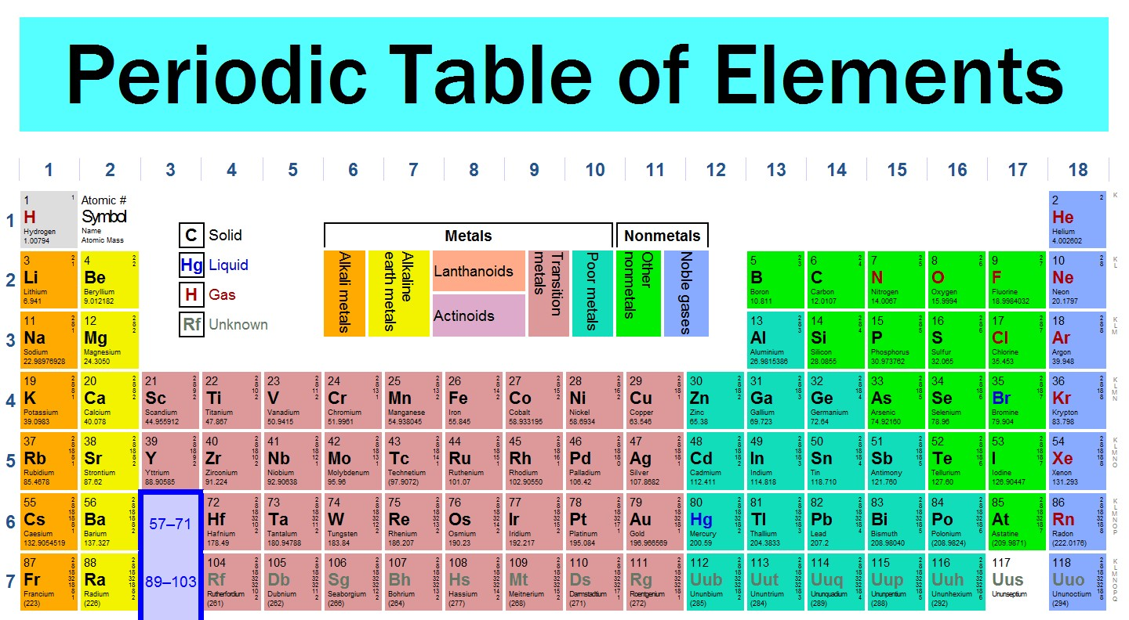
The Chosen One - Silicon

Slide 11
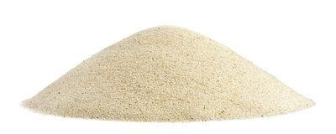
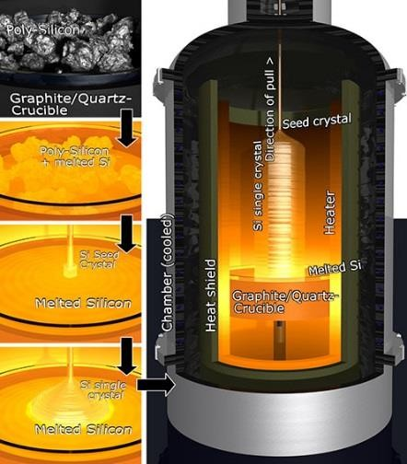

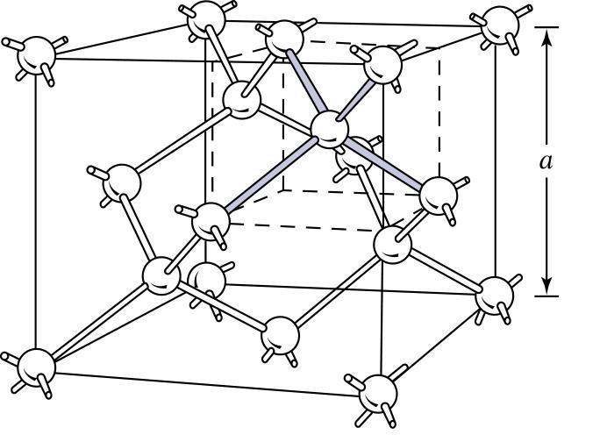
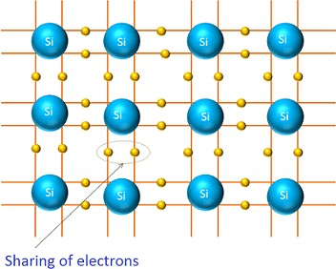
The Chosen One - Silicon
Sand Pile
Amorphous
Si Wafer
Single Crystalline

Slide 12
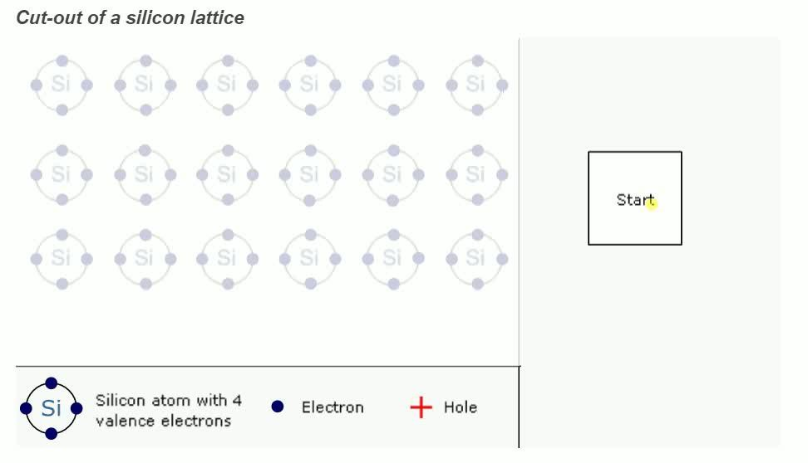
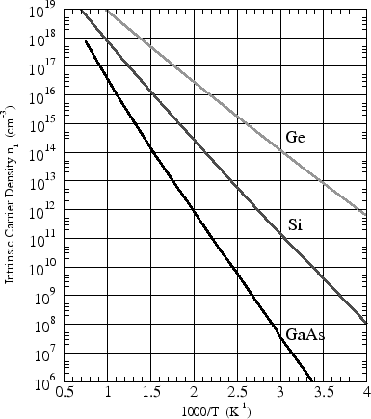
Electrons and Holes
For intrinsic semiconductor, n₀ = p₀ = n_{i} :
Boltzmann distribution:
E_{g} k_{B}T
−
n ² = n p = N N e
i 0 0 C V
When freed from a covalent bond, an electron leaves a “void” behind because the bond is now
incomplete. The “void” is called a “hole”.
An electron-hole pair is generated when an electron is freed from the bond; an electron-hole recombination occurs when an electron falls into a hole.
n_{i} is strongly dependent on temperature! -> Not good for applications
➢

Slide 13
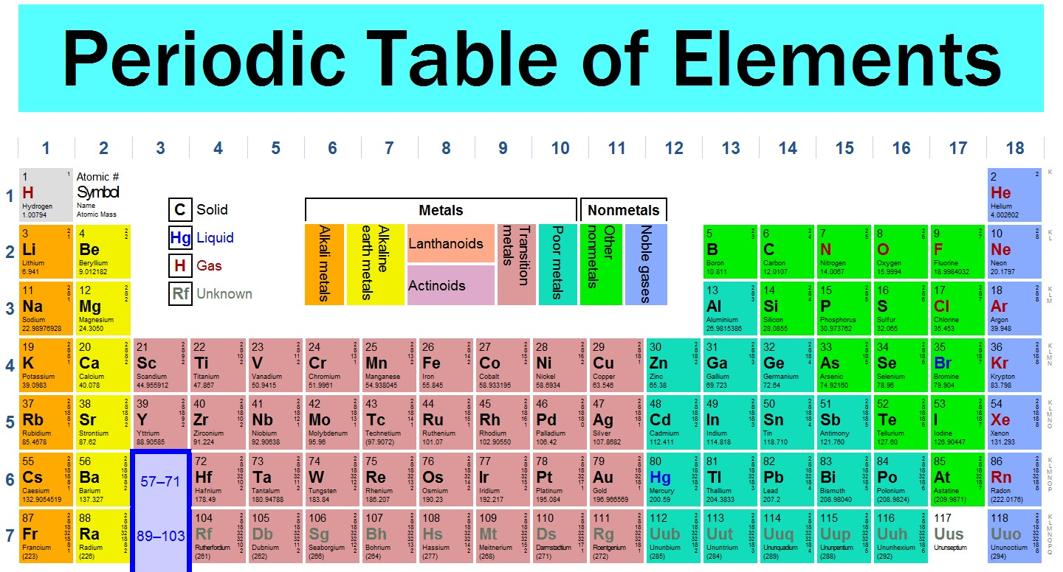
Dope the Silicon Wafer

Slide 14
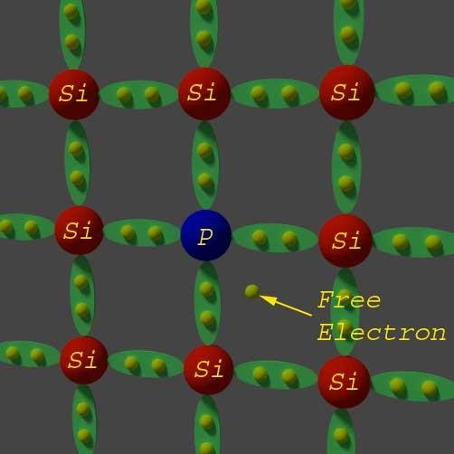
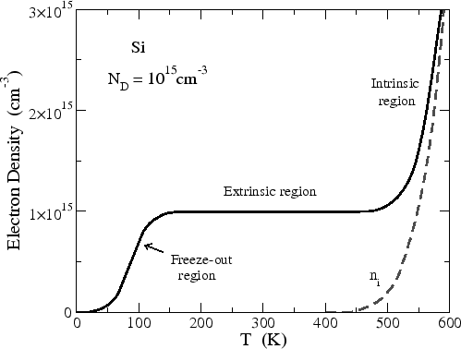
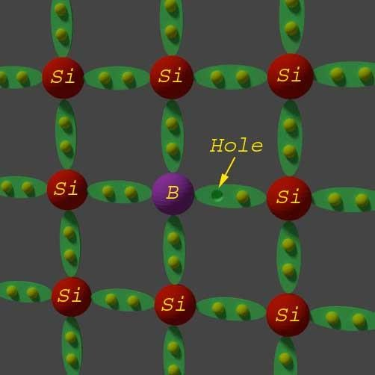
n-type Si vs. p-type Si
n-type
p-type
region of
interest
+
-
P atom’s outmost orbit has 5 electrons.
“donor”: a n-type dopant with an “extra” valence electron and can easily donate an electron to the conduction band, and
B atom’s outmost orbit has 3 electrons.
“acceptor”: a p-type dopant with a “missing” valence electron and can easily donate a hole to the valence band, and leaves a negative B⁻ atom at local position.
_{P}+
leaves a positive atom at local
position.

Slide 15
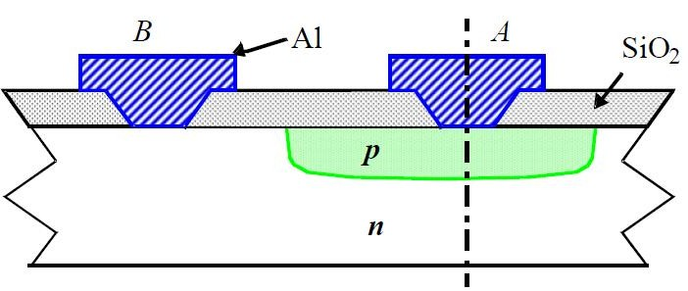
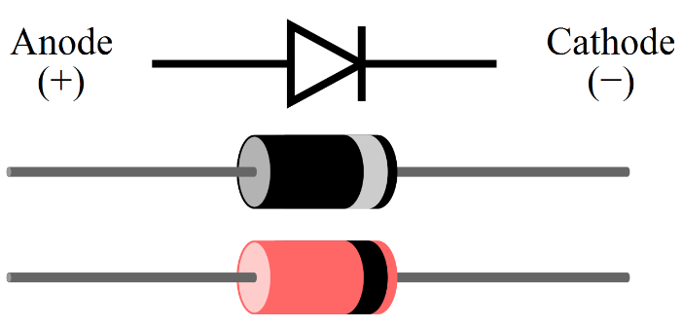
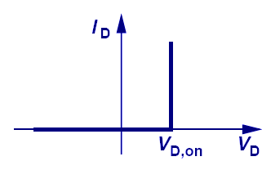
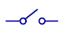
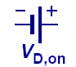
Two Terminal Electronic Switch - Diode
Need Three-Terminal
The switch mechanism is manipulated by electrical field
-> Transistor
OFF
ON
OFF
ON
Passively controlled by the biased voltage!

Slide 16
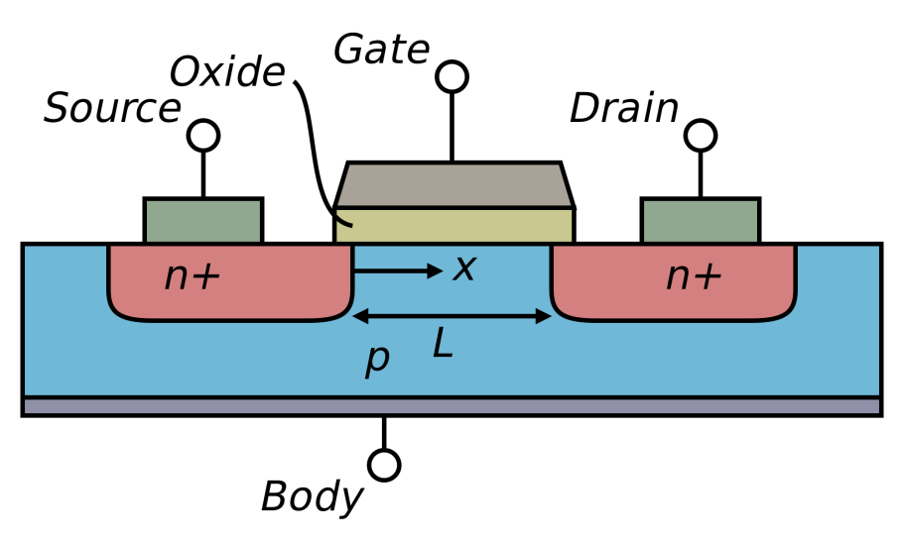
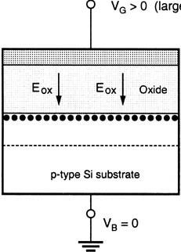
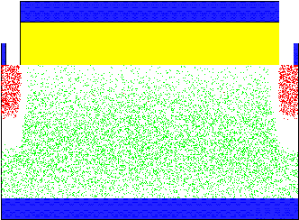
The Final Winner - MOSFET
V_{G} > 0
Large
Electron
- - - - - - - -
Hole
With the increase of V_{gs}
On/Off
On-state: carrier channel formed, where the current can flow
Off-state: carrier channel does not exist, no path for current to pass
Control
Actively controlled by electrical field
Most importantly, MOSFET can be scaled down!

Slide 17
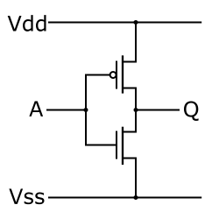
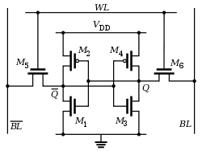
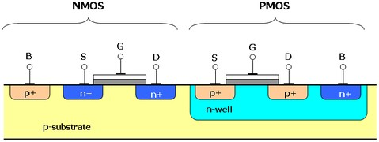
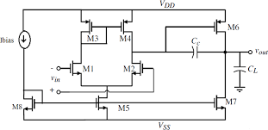
The Final Winner - MOSFET
Complementary MOS (CMOS)
Digital
Memory
Analog
CMOS is the driving engine for Info. Sci. & Tech.!
To drive the unprecedented revolution of the information era
Economical Scaling from sizes to nanometer – Moore’s Law

Slide 18
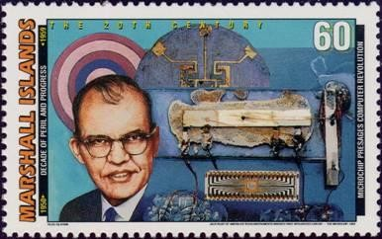
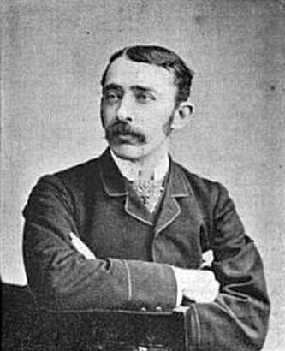
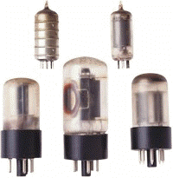
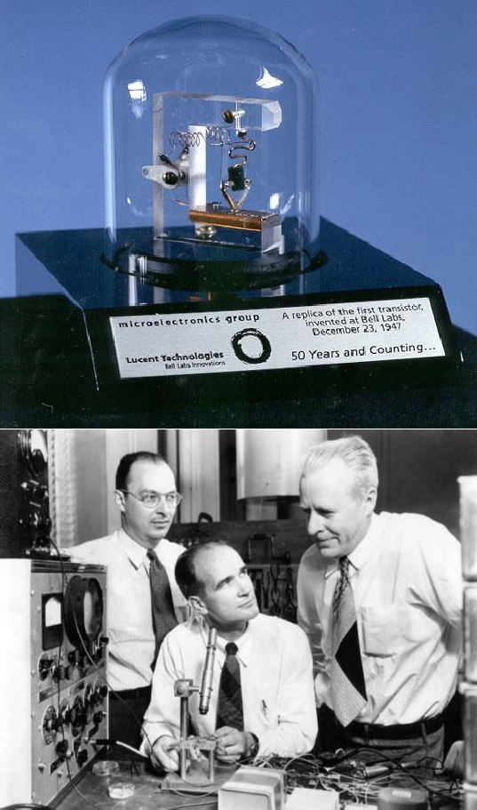
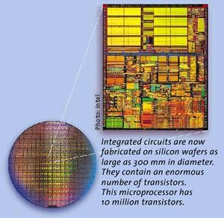
Evolution of the Transistor
1958, First IC, Texas Instruments
1904, Vacuum tube
Modern IC
1947, bipolar transistor, Bell Lab

